Slide 1
Lecture 7-1
Application & Tips:
Learning rate, data preprocessing, overfitting
Sung Kim <hunkim+mr@gmail.com>
http://hunkim.github.io/ml/

Slide 2
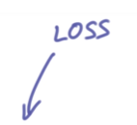
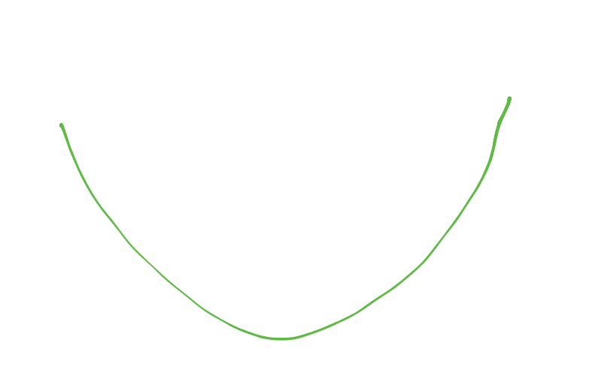
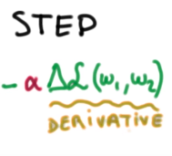
Gradient descent
https://www.udacity.com/course/viewer#!/c-ud730/l-6370362152/m-6379811827

Slide 3
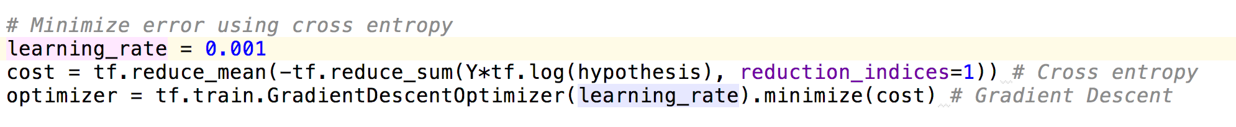
Gradient descent
https://www.udacity.com/course/viewer#!/c-ud730/l-6370362152/m-6379811827

Slide 4
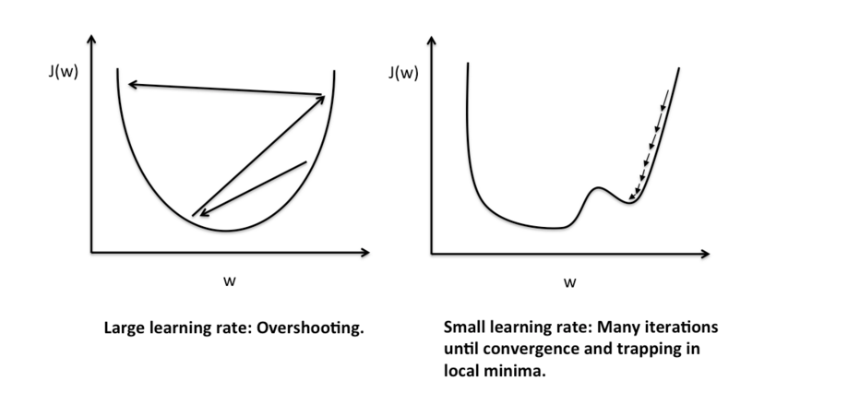
Large learning rate: overshooting
http://sebastianraschka.com/Articles/2015_singlelayer_neurons.html

Slide 5
Small learning rate:
takes too long, stops at local minimum
http://sebastianraschka.com/Articles/2015_singlelayer_neurons.html

Slide 6
Try several learning rates
Observe the cost function
Check it goes down in a reasonable rate

Slide 7
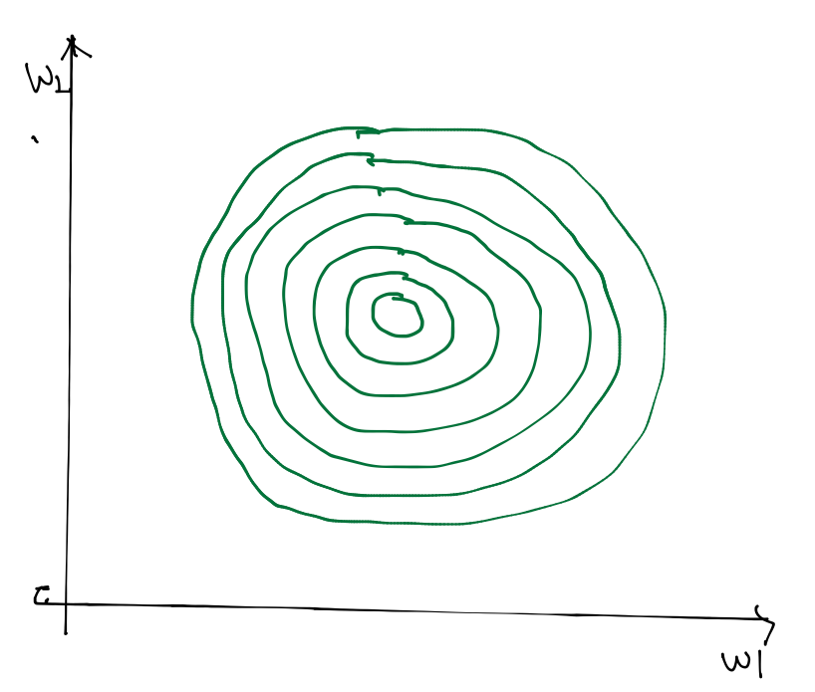
Data (X) preprocessing for gradient descent

Slide 8
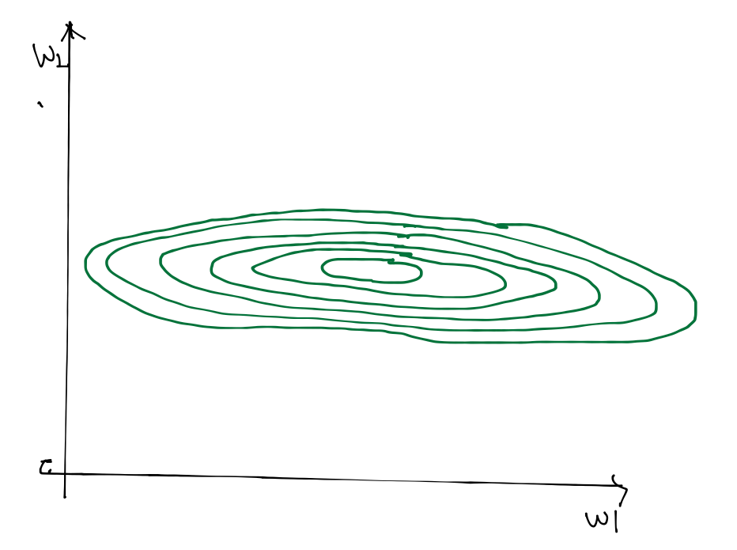
Data (X) preprocessing for gradient descent
x1 | x2 | y
1 | 9000 | A
2 | -5000 | A
4 | -2000 | B
6 | 8000 | B
9 | 9000 | C

Slide 9
Data (X) preprocessing for gradient descent
x1 | x2 | y
1 | 9000 | A
2 | -5000 | A
4 | -2000 | B
6 | 8000 | B
9 | 9000 | C

Slide 10
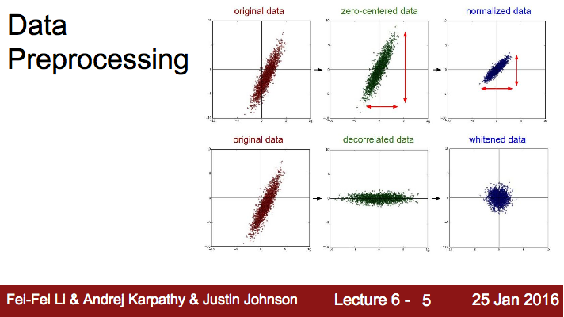
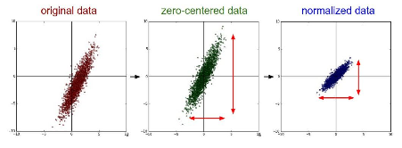
Data (X) preprocessing for gradient descent

Slide 11

Standardization
http://sebastianraschka.com/Articles/2015_singlelayer_neurons.html

Slide 12
Overfitting
Our model is very good with training data set (with memorization)
Not good at test dataset or in real use

Slide 13
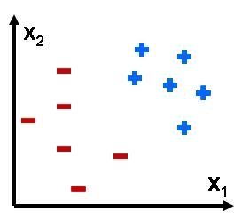

Overfitting

Slide 14
Solutions for overfitting
More training data!
Reduce the number of features
Regularization

Slide 15
Regularization
Let’s not have too big numbers in the weight

Slide 16
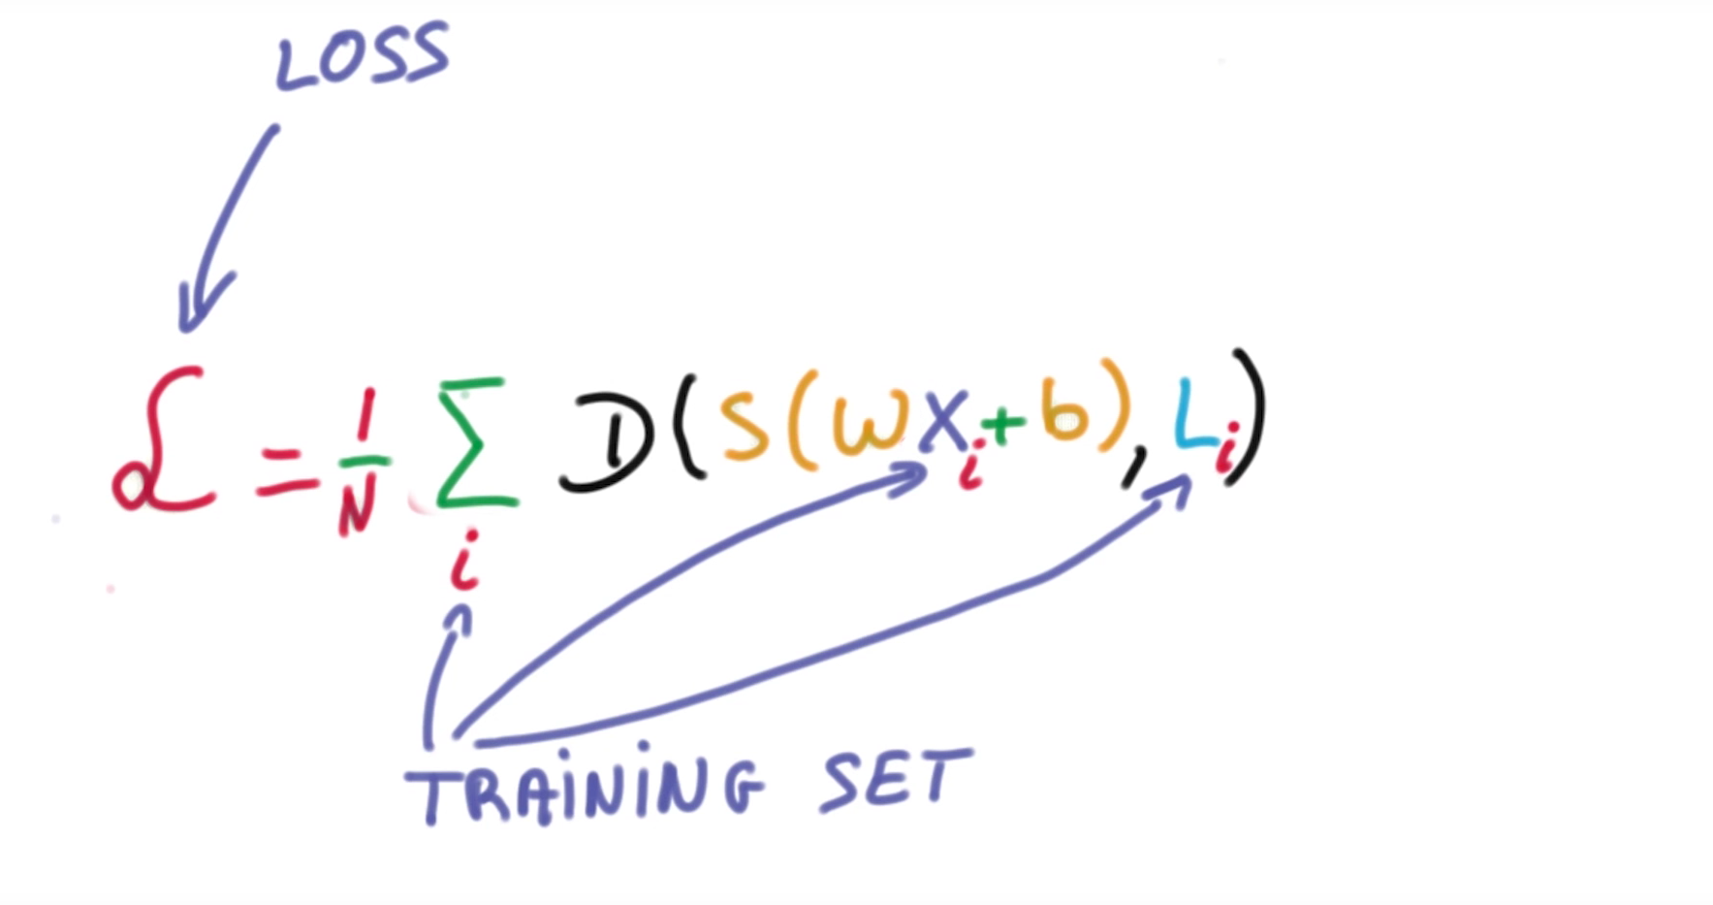
Regularization
Let’s not have too big numbers in the weight

Slide 17

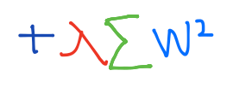
Regularization
Let’s not have too big numbers in the weight

Slide 18
Regularization
Let’s not have too big numbers in the weight

Slide 19
Summary
Learning rate
Data preprocessing
Overfitting
More training data
Regularization

